Slide 1

DETECTION OF PHISHING WEBSITES USING MACHINE LEARNING
Presented by
Lakshan Balaji R K (20EUCS069)
Dhinakaran V (21EUCS504)
Sruthi R (21EUCS514)
Guided by
Dr.K.Ramesh
Professor , Department of CSE
Sri Krishna College of Engineering & Technology (Autonomous)
Coimbatore

Slide 2
Abstract
Criminals seeking sensitive information construct illegal clones of actual websites and e-mail accounts. The e-mail will be made up of real firm logos and slogans. When a user clicks on a link provided by these hackers, the hackers gain access to all of the user’s private information, including bank account information, personal login passwords, and images.
Phishing is a widespread tactic used to trick gullible people into disclosing their personal information by using bogus websites. Phishing website URLs are designed to steal personal data, including user names, passwords, and online financial activities. Phishers employ websites that resemble those genuine websites both aesthetically and linguistically. Utilizing anti-phishing methods to identify phishing is necessary to stop the rapid advancement of phishing techniques as a result of advancing technology.

Slide 3
Objective
The system should be able to identify phishing websites as early as possible to minimize the potential damage caused by attackers.
The detection system should have a low false positive rate to avoid flagging legitimate websites as phishing sites, as this can lead to user inconvenience.
Incorporate historical data about known phishing websites to improve the system's accuracy. This can involve leveraging threat intelligence feeds and databases.

Slide 4
Introduction
Phishing is a type of cyber attack in which attackers attempt to trick individuals into divulging sensitive information, such as usernames, passwords, and financial details, by posing as a trustworthy entity.
The attackers typically use deceptive emails, messages, or websites to mimic legitimate organizations or individuals to manipulate the target into providing confidential information or performing actions that could compromise their security.
Phishing attacks are often carried out with the goal of stealing sensitive information for financial gain, identity theft, or unauthorized access to systems and accounts.
A phishing website is a fraudulent website designed to deceive visitors into believing that they are interacting with a legitimate and trustworthy entity.

Slide 5
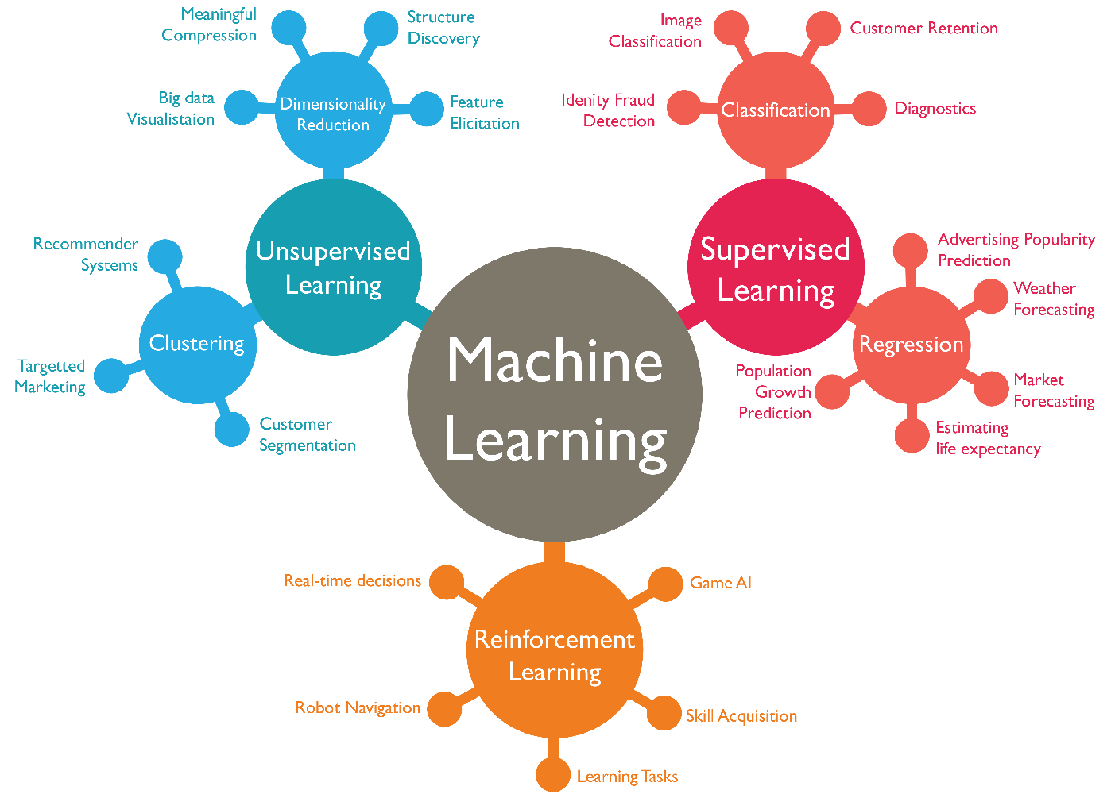
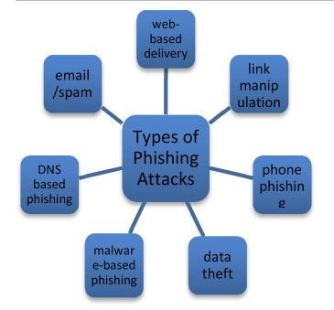
Domain Review

Slide 6
Machine Learning
Machine learning is a subset of artificial intelligence (AI) that focuses on the development of algorithms and statistical models, allowing computer systems to improve their performance on a specific task over time without being explicitly programmed.
Supervised Learning is a category of machine learning where the model is trained on a labelled dataset, learning the relationship between input data and corresponding output labels. It is commonly used for tasks such as classification and regression.
Various metrics, such as accuracy, precision, recall, and F1 score, are used to assess the performance of machine learning models. The choice of metrics depends on the nature of the task and the desired outcome.

Slide 7
Gradient Boosting Classifier
Random Forest is an ensemble learning algorithm that operates by constructing a multitude of decision trees at training time and outputting the class that is the mode of the classes (classification) or mean prediction (regression) of the individual trees.
It is an extension of bagging (Bootstrap Aggregating) that builds multiple decision trees and merges them together to get a more accurate and stable prediction.
Random Forest is a versatile and powerful algorithm that is widely used for both classification and regression tasks in various domains such as finance, healthcare, and natural language processing.

Slide 8
LITERATURE REVIEW
Author and Year | SLR or Not | Analyzed Analytics | Aim | Main Findings | Limitations
Qabajeh et al., 2018 | No | 67 | This review paper compares traditional anti-phishing methods, which includes raising awareness, educating users, conducting periodic training or workshop, and using a legal perspective. The Computerized anti-phishing techniques talk about list-based and machine-learning techniques. | Machine Learning and rule induction are suitable to combat phishing due to their high detection rate and, more importantly, the easy-to-understand outcomes. | Sixty-seven studies were analyzed in work, and the research did not discuss Deep Learning techniques.
Zuraiq and Alkasassbeh, 2019 | No | 18 | This study examines several phishing detection methods, including heuristic, content-based, and fuzzy rule-based methods. | The study indicated no perfect method for identifying phishing websites | The work analyzed only 18 studies and did not include Machine Learning, List-based, and Deep Learning approaches.
Kunju et al., 2019 | No | 14 | This paper provides an overview of many Machine Learning algorithms for identifying phishing websites, including kNN, Naive Bayes, Decision tree, SVM, Neural Network, and Random Forest. | According to this study, phishing website detection using a single approach is insufficient. | The literature in this work included only 14 studies discussing Machine Learning techniques.
Basit et al., 2020 | No | 21 | For phishing detection, the study examines Artificial intelligence approaches such as Machine Learning, Hybrid Learning, Scenario-based, and Deep Learning. | The study proved that Machine Learning procedures give the best results. | The work analyzed only 21 research items.

Slide 9
EXISTING SYSTEM WITH DEMERITS
In the existing system they have used Logistic Regression, Multinomial Naive Bayes, and XG Boost are the machine learning methods that are compared. The Logistic Regression algorithm outperforms the other two. The model is preprocessed in the proposed system, the words are tokenized, and stemming is performed. Data Processing is the process of converting or encoding data for easy machine transfer. The accuracy of Logistic Regression is 96.63 percent, and the overall comparison is presented.
Demerits:
The existing models have low latency
Existing systems do not have a specific UI.
The existing system may not be accurate if sample size is too small

Slide 10
PROPOSED SYSTEM WITH MERITS
The Existing system is an interactive and responsive website that will be used to detect whether a website is legitimate or phishing. This website is made using different web designing languages which include HTML, CSS, Javascript and Flask framework in Python. The proposed system is developed using the Gradient Boosting Classifier.
Merits:
UI is provided.
Model is trained using many features.
High level of accuracy.
Can handle some of the missing parameters natively.

Slide 11
SYSTEM ARCHITECTURE
Pre-processing and Feature Selection
Gradient Boosting Classifier
Predicted Results: Phishing Website or Legitimate website
Dataset
Performance Analysis and Graph

Slide 12
SYSTEM MODULES
UI designed using HTML, CSS.
Scripted using Javascript.
Flask framework is implemented using python.
Implementation of ML algorithm using JUPYTER Notebooks
Loading the data
Familiarizing with data & EDA
Visualizing the data
Splitting the data
Training the data

Slide 13


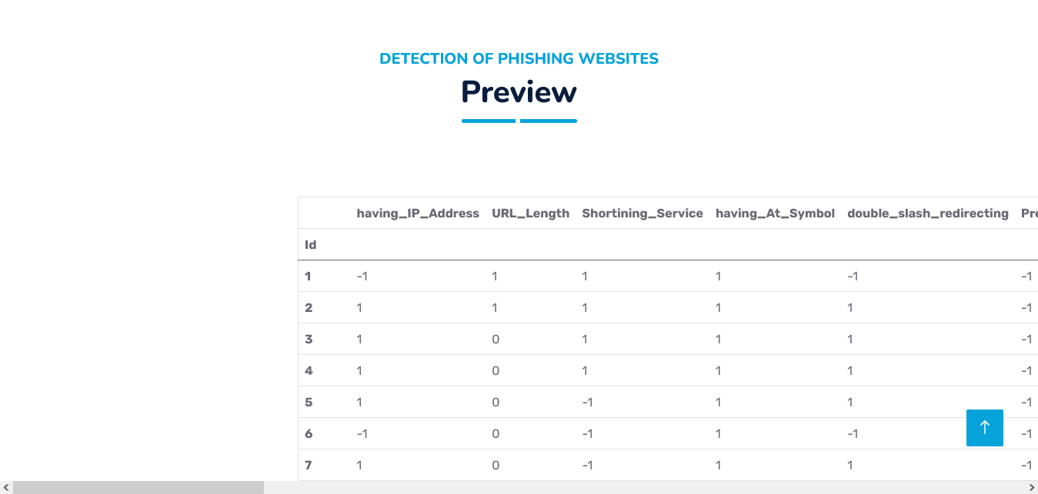
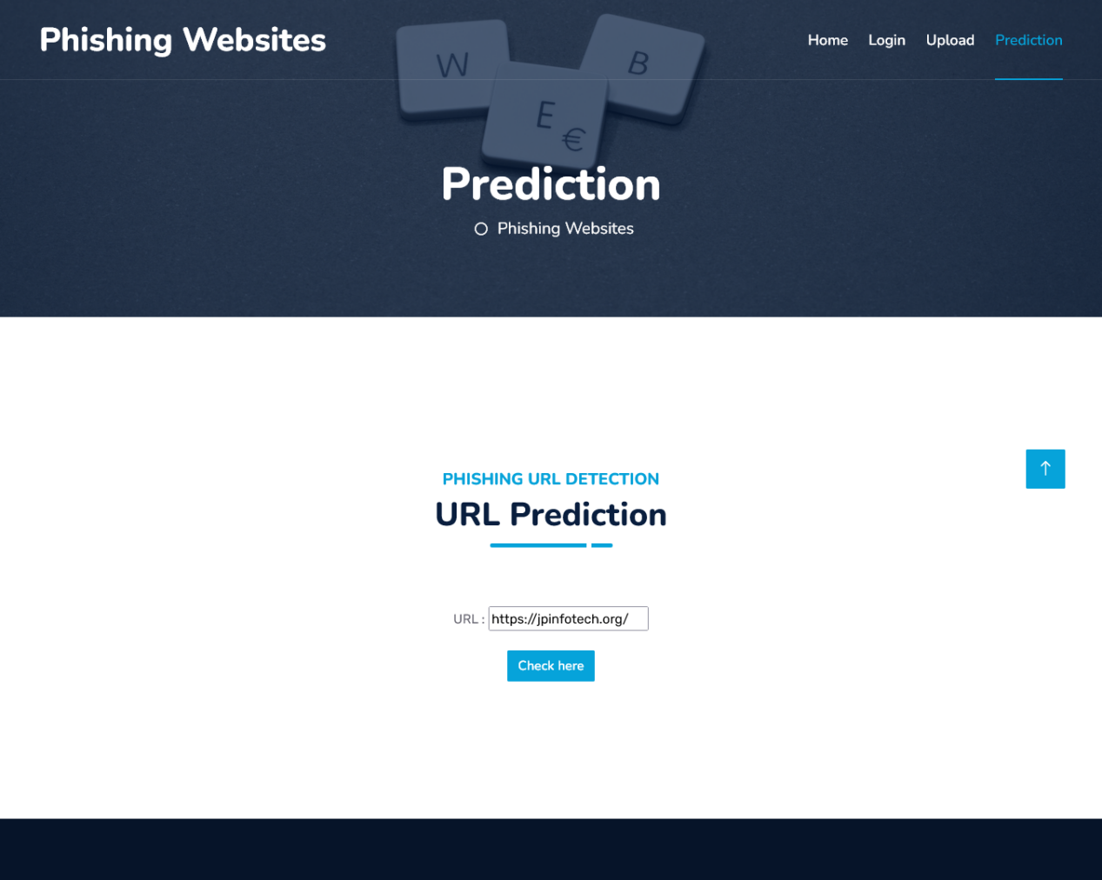
SAMPLE OUTPUT

Slide 14
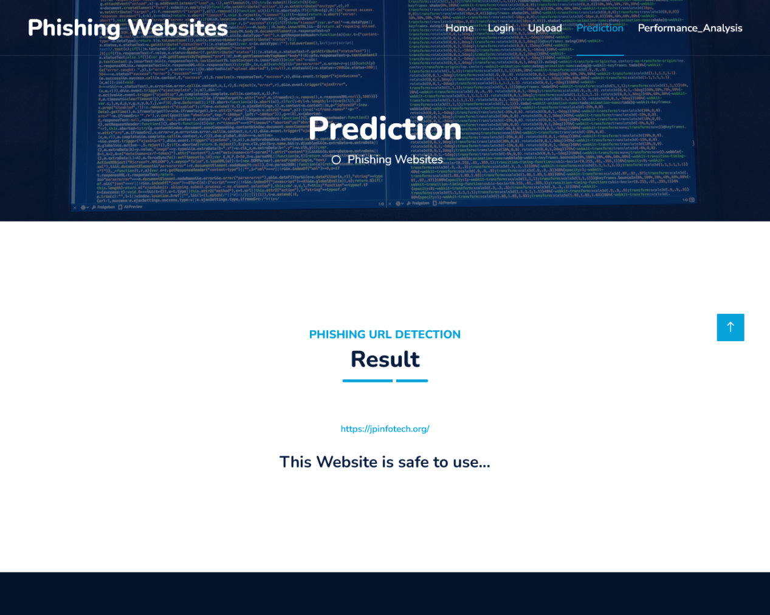
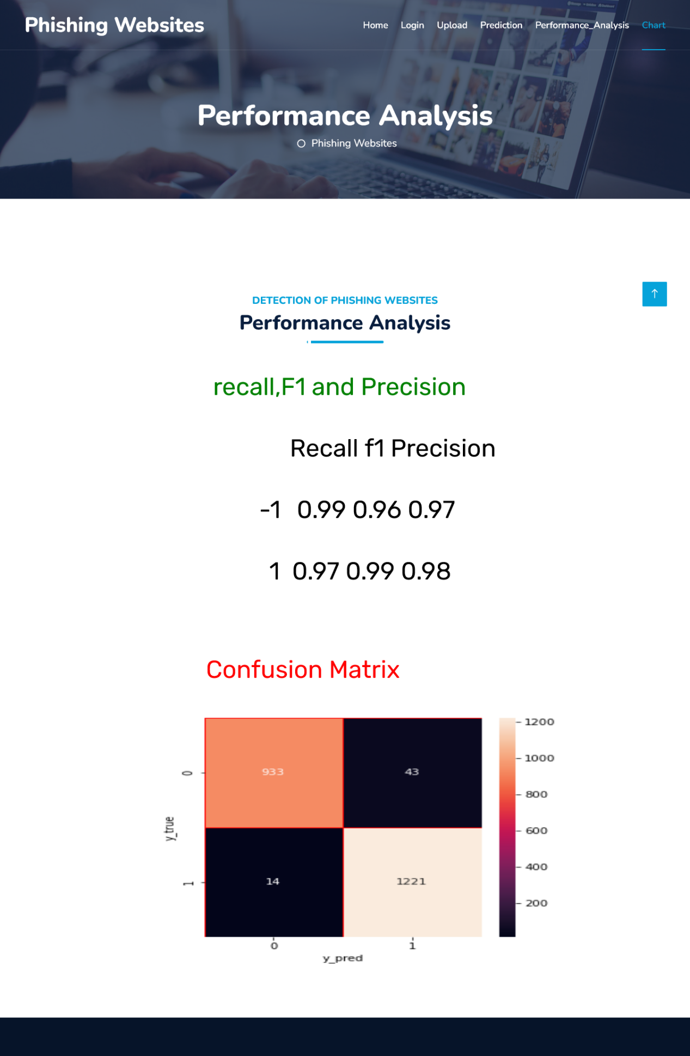
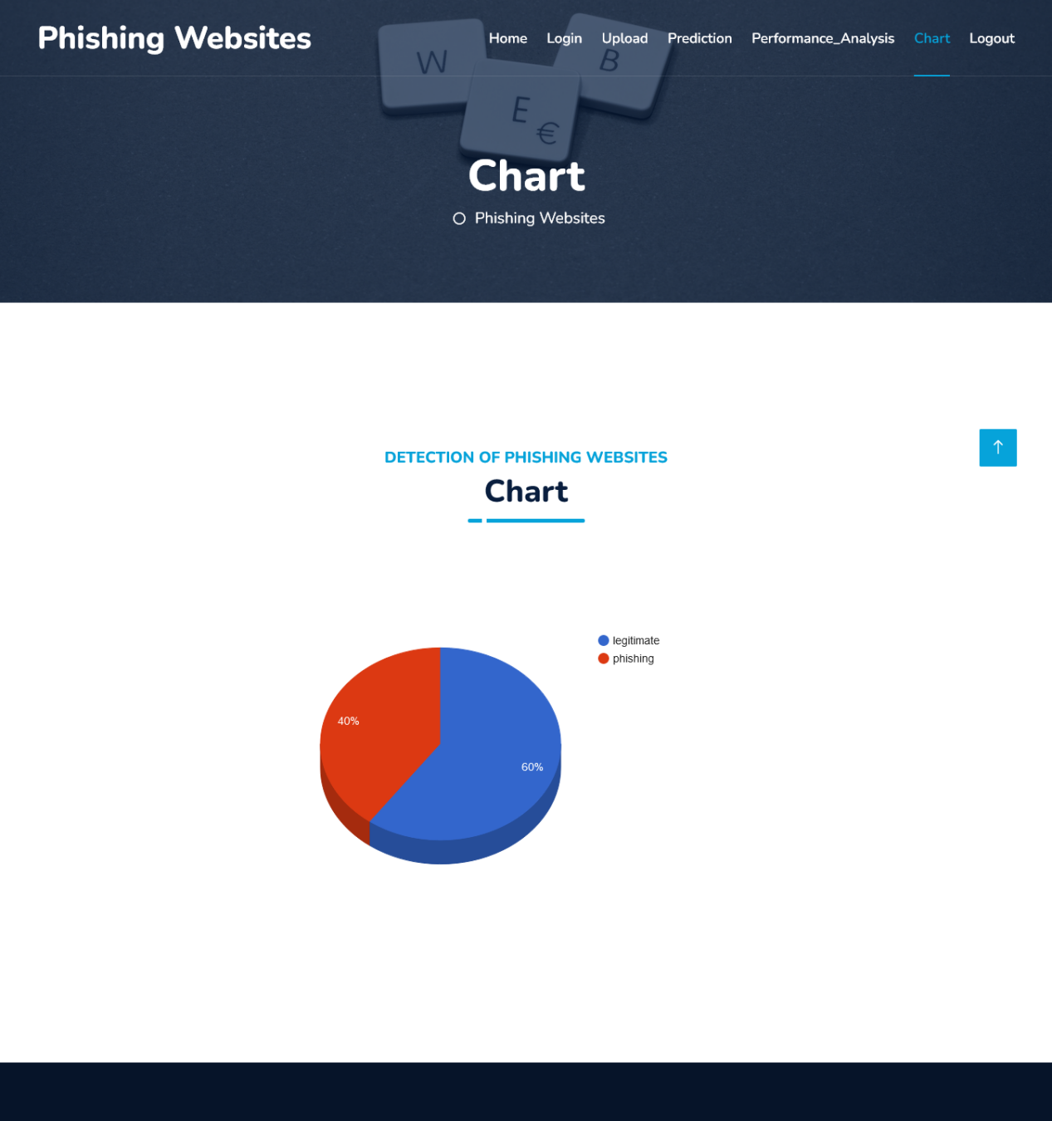

Slide 15
Conclusion
The main purpose of phishing detection system is providing a feasible way of identifying fake phishing websites.
The proposed system can be accessed through a website and appropriate details can be entered.
From the result of the model, we can conclude that the proposed system can give slightly accurate results with respect to the given dataset.
The model has its drawbacks if the provided dataset is not accurate.

Slide 16
REFERENCES
https://www.sciencedirect.com/science/article/pii/S1319157823000034
https://www.researchgate.net/publication/328541785_Phishing_Website_Detection_using_Machine_Learning_Algorithms
https://www.ncbi.nlm.nih.gov/pmc/articles/PMC8504731/
https://www.mdpi.com/2076-3417/13/8/4649
https://ijcrt.org/papers/IJCRTI020051.pdf
https://ieeexplore.ieee.org/document/8769571
https://www.javatpoint.com/machine-learning-random-forest-algorithm
https://nevonprojects.com/detecting-phishing-websites-using-machine-learning/
https://papers.ssrn.com/sol3/papers.cfm?abstract_id=4208185

